Slide 1
Creative Sound walk Workshop
GUI Ren
School of Creative Media
City University of Hong Kong
2023.11.29

Slide 2
Deep listening exercise

Slide 3
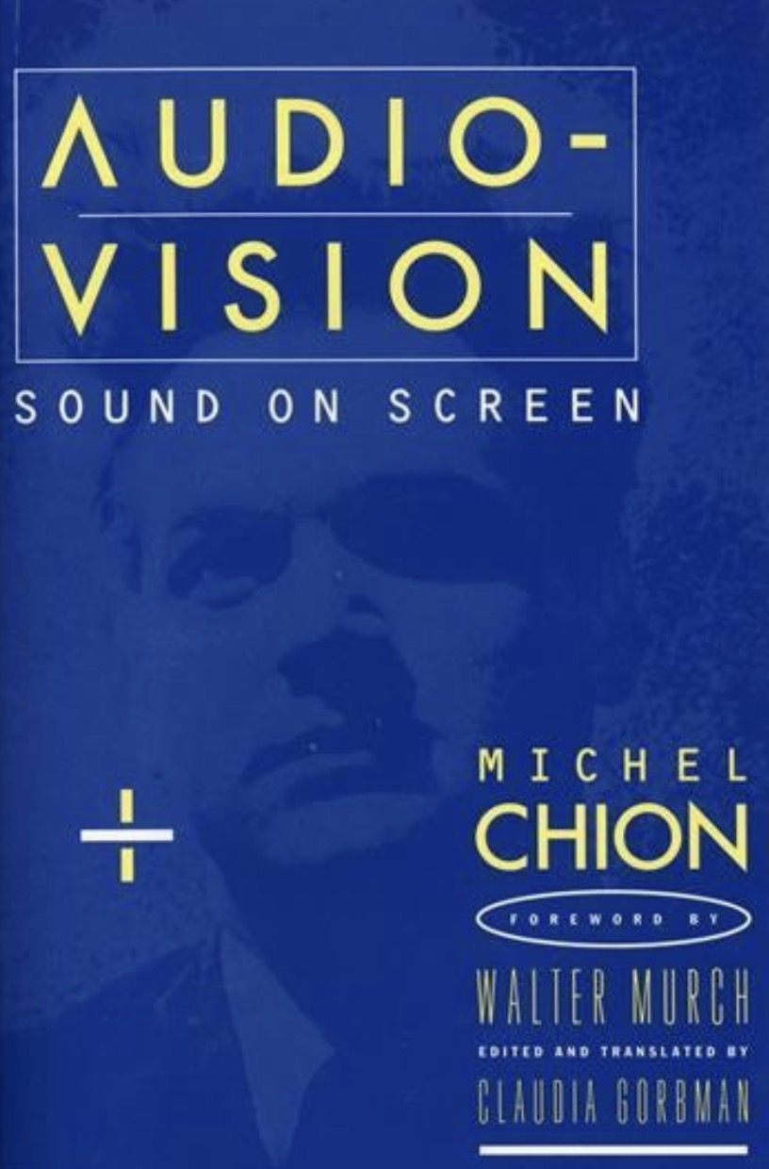
The three listening mode
Causal listening 因果聆听
“gather information about its cause (or source) ... but also the most easily influenced and deceptive mode of listening.” (Chion 1994, 25-26)
Semantic listening 语义聆听
“a code or a language to interpret a message” (Chion 1994, 28)
Reduced listening 还原聆听
“focus on the traits of the sound itself, independent of its cause and of its meaning” (Pierre Schaeffer)
Chion, Michel. 1994. Audio-Vision: Sound on Screen.

Slide 4
Sound walk

Slide 5
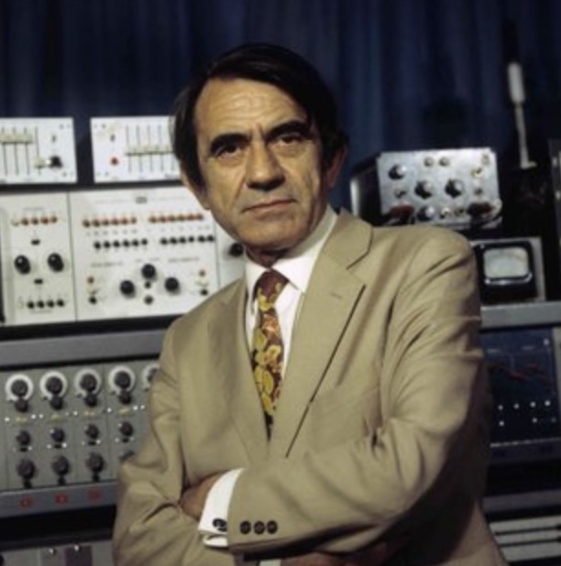
Pierre Schaeffer
concrete music
sound object
Acousmatic
clashing?....

Slide 6
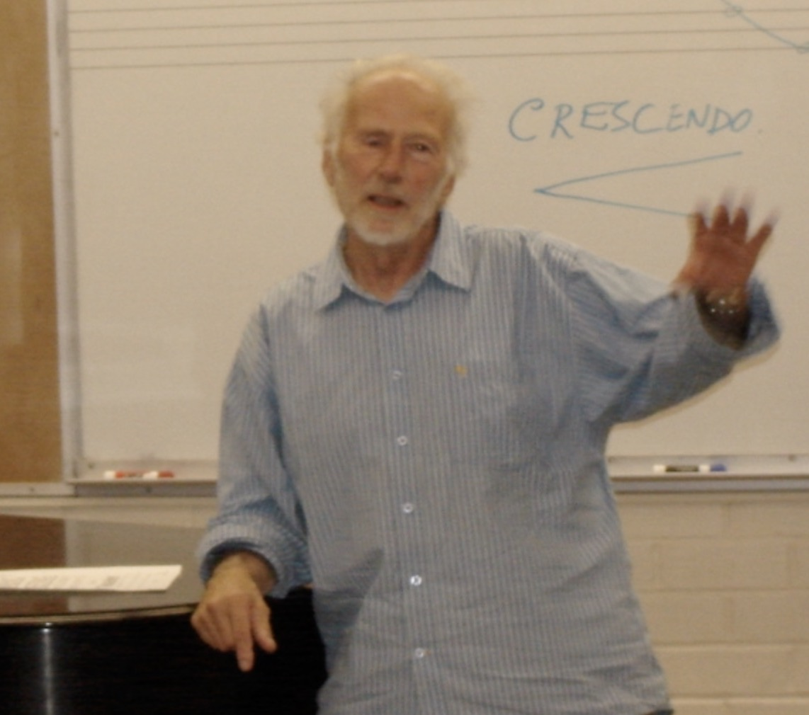
The World Soundscape Project
“Soundscape, that is, sound environment. Specifically, any composition as a sound environment is regarded as it. The scope of research" (Schafer, 1977).
“An acoustic environment as perceived or experienced and/or understood by a person or people in context”(ISO 12913–1, 2014)
R. Murray Schafer
The World Soundscape Project
https://www.sfu.ca/~truax/wsp.h

Slide 7
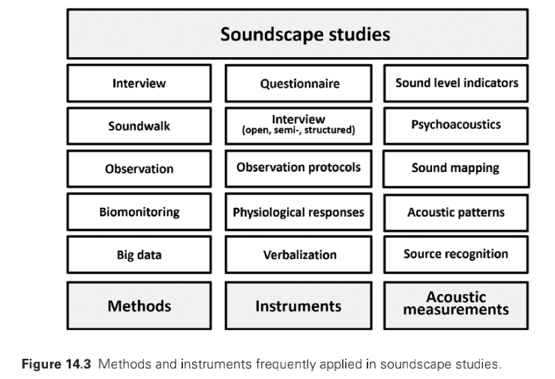
Soundscape studies

Slide 8
Sound Walk
Listening Walk & Sound Walk
“The sound walk is an exploration of the soundscape of a given area using a score as a guide”
Hildegard Westerkamp - a co-founder of WSP
Sound walk is “any excursion whose main purpose is listening to the environment.”
Barry Truax
the intent listening, without the distraction of operating a recorder
Andrea McCartney
Using soundwalking method as an artistic way, evolved it from a methodological tool to recent artistic approaches

Slide 9
Sound walks
Viv Corringham 2003
Shadow walks
http://vivcorringham.org/shadow-walks.html
Christina Kubisch 2003
Electric walks
https://electricalwalks.org/about/
Andra McCartney 2011
Soundwalking and the Bodily Exploration of Places

Slide 10
Sound walk

Slide 11
Your sound story?

Slide 12
Let’s go for a sound walk!

Slide 14
After sound walk
What do you hear？
Which kind of sounds will attract your attention?
What’s the difference before the previous walk experience?
Do you have a sound preference?
How do your groups engaged with the environment?

